Slide 1


Technical Skills
www.techleadacademy.io
©2019 by TechLead Academy

Slide 2




Welcome
Technical Skills
By Alex Rodriguez
www.techleadacademy.io
©2019 by TechLead Academy

Slide 3

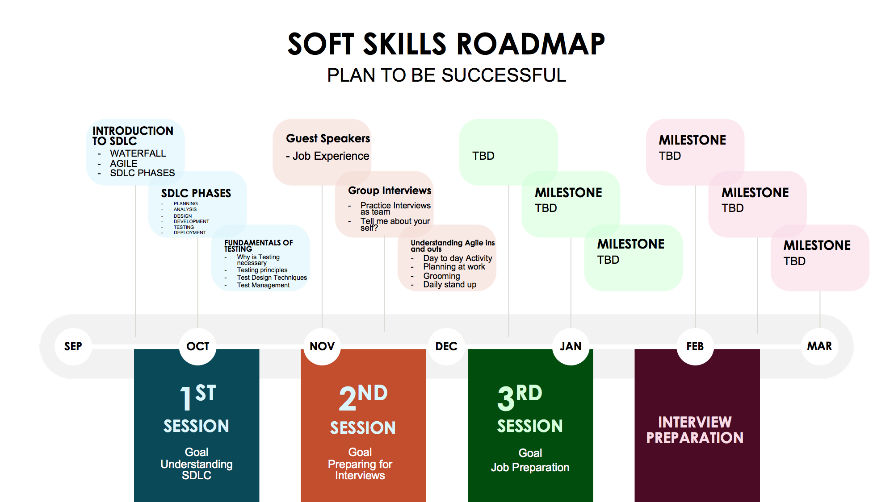

www.techleadacademy.io
©2019 by TechLead Academy

Slide 4
Class Schedule
Week 1 - 2 :
About Tech Lead Principles, Introduction to Scrum and Waterfall, SDLC
Week 3 - 4 :
Understanding different methodologies
Week 5:
SDLC Phases
Week 6 - 10:
Fundamentals of Testing
Week 11 - 15:
Understanding Agile
Week 16 - 20:
Interview Preparation
Week 21 - 30:
Guest speakers - Project Manager, SDET’s Professionals, Resume Preparation, Market Preparation.
www.techleadacademy.io
©2019 by TechLead Academy

Slide 5

Looking into Spring 2020
www.techleadacademy.io
©2019 by TechLead Academy

Slide 6
Professional communication
Team work
Support your team mate
www.techleadacademy.io
©2019 by TechLead Academy

Slide 7
Tech Lead Academy will go with the speed of the class
Class will get easier for consistent, hard workers and humble like you
Here at Tech Lead Academy we want everyone to be treated EQUALLY.
www.techleadacademy.io
©2019 by TechLead Academy

Slide 8
Certifications
Highly Recommended Certifications to look into

Slide 9
Use your time wisely
If the class is too slow for you work on your certification (use the OCA book)
You can start Preparing for mentoring.
One on one or to the team
www.techleadacademy.io
©2019 by TechLead Academy

Slide 10
What to do if you fall behind
Use @channel in slack #software-development-engineer-in-test
www.techleadacademy.io
©2019 by TechLead Academy

Slide 11
Online Presence
Google your name
Clean up your Social Media
Any Record
Having no online profile is better than
Having a bad profile
www.techleadacademy.io
©2019 by TechLead Academy

Slide 12
Monthly income $3000
If you dedicate 7 months of class
7 X $3000 = ($21000)
After finding a job
Monthly Income $6000
If you commit yourself you would make up what you lost in 4 months
$6000 X 4 = $24000
www.techleadacademy.io
©2019 by TechLead Academy

Slide 13
www.techleadacademy.io
©2019 by TechLead Academy

Slide 14
Let me ask my friend Google
www.techleadacademy.io
©2019 by TechLead Academy

Slide 15
Break

Slide 16
Introduction to Agile vs Waterfall
www.techleadacademy.io
©2019 by TechLead Academy

Slide 17
Agile vs Waterfall
www.techleadacademy.io
©2019 by TechLead Academy

Slide 18
Agile vs Kanban
www.techleadacademy.io
©2019 by TechLead Academy

Slide 19
Agile Rules
Every Sprint is four weeks or less in Duration
Every Sprint is the Same Length
The intention of Every Sprint is Potentially Shippable software
Every Sprint includes Sprint Planning
The Daily Scrum is time boxed to 15 minutes
Every Sprint Includes Sprint Review for Stakeholder feedback on product
Every Sprint includes Sprint Retrospective
www.techleadacademy.io
©2019 by TechLead Academy

Slide 20
Every Sprint is four weeks or less in Duration
www.techleadacademy.io
©2019 by TechLead Academy

Slide 21
Potential deployment product
www.techleadacademy.io
©2019 by TechLead Academy

Slide 22
Daily Stand Up
Meet in daily basis for 15 minutes
www.techleadacademy.io
©2019 by TechLead Academy

Slide 23
Sprint Planning
Implementation of product backlog
Start of sprint planning meeting = scrum team will work/discuss the initial plan for completing the product backlog items
Establish goals for the sprint
www.techleadacademy.io
©2019 by TechLead Academy

Slide 24
Grooming / sizing
Grooming the backlog (User Stories)
Prioritization
Sizing (using Fibonacci point)
www.techleadacademy.io
©2019 by TechLead Academy

Slide 25
Sprint Review / Demo
Sprint Goals
What was planned to achieve
Status Overview
Finished and unfinished
Added and removed items
Changed priorities
Live Demo
Demonstration of functionalities in the sprint
Impediments
Risks Identified in the sprint
Feedback time
Feedback from every stakeholder
Done done !
www.techleadacademy.io
©2019 by TechLead Academy

Slide 26
Retrospective
Team discuss and determine what can be changed to improve and be more productive in the next sprint
www.techleadacademy.io
©2019 by TechLead Academy

Slide 27
Group Activity
Making Peanut Butter and Jelly
www.techleadacademy.io
©2019 by TechLead Academy

Slide 28
SDLC
Software Development Life Cycle
www.techleadacademy.io
©2019 by TechLead Academy

Slide 29
Planning
Conducted by manager & senior leadership
Finalize project schedule, cost analysis, time estimation.
PM to create deliverables
Stakeholders role
www.techleadacademy.io
©2019 by TechLead Academy

Slide 30
Requirements
Gather and draft project requirements
BA (Business Analyst) organizes and facilitates requirements gathering.
BA will be responsible for every feature
BA is in charge to facilitate meetings to get more details for application from stake holder.
www.techleadacademy.io
©2019 by TechLead Academy

Slide 31
Examples
Question: Where was the Declaration of Independence signed?
Answer: At the bottom of the page
Question: What is the main reason for divorce?
Answer: Marriage
Question: What looks like half an apple?
Answer: The other half
Logically the answers are correct but if we don’t gather enough information and there is miscommunication we can end up with the wrong product
www.techleadacademy.io
©2019 by TechLead Academy

Slide 32
Design
Picture is worth a thousand words
Create business process flows
Who is in charge of Design?
BA has a big role in this phase.
www.techleadacademy.io
©2019 by TechLead Academy

Slide 33
Development
Application Development - performed by developers
Platform: Java, .net, PHP, Python, Javascript etc.
Code Created: Code Review
www.techleadacademy.io
©2019 by TechLead Academy

Slide 34
Testing
Performed by BAs or QAs
Find all possible defects, bugs and discrepancies in the system
Defect logging is an integral part of testing
Tools: Eclipse, Intellij, BDD Framework, Maven, Jira for logging, test plan etc..
www.techleadacademy.io
©2019 by TechLead Academy

Slide 35
Deployment
Migration of Code
Development is done, Testing is done
Documents: User Manual, training and presentations
www.techleadacademy.io
©2019 by TechLead Academy

Slide 36
Maintenance
Make sure application is running.
www.techleadacademy.io
©2019 by TechLead Academy

Slide 37
Group Activity
Person A: Asks question
Person B: Answers question
www.techleadacademy.io
©2019 by TechLead Academy

